Slide 1
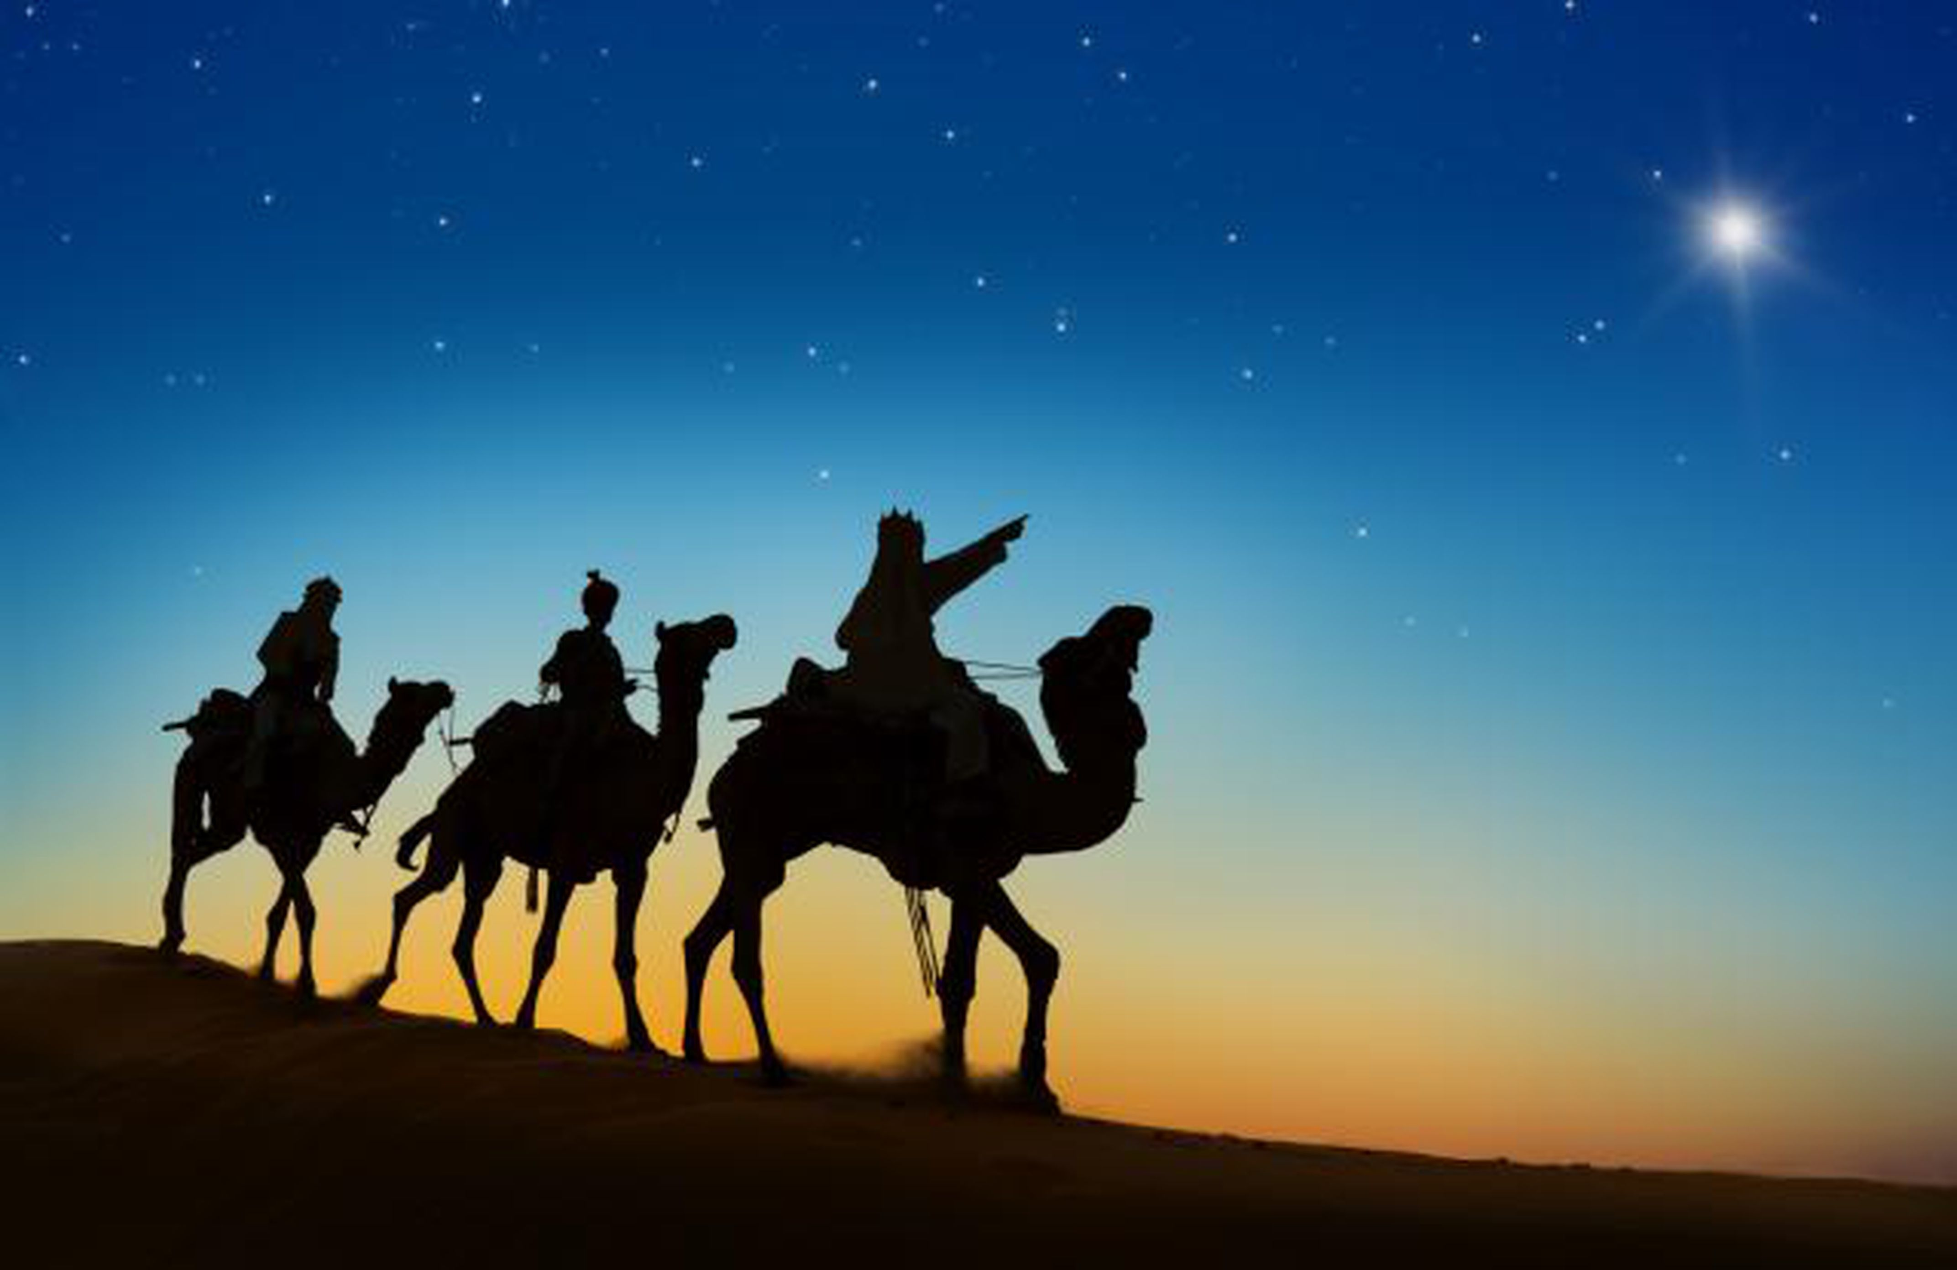
Sunday, January 10, 2021
Culmore
United Methodist Church
Words and Music

Slide 2
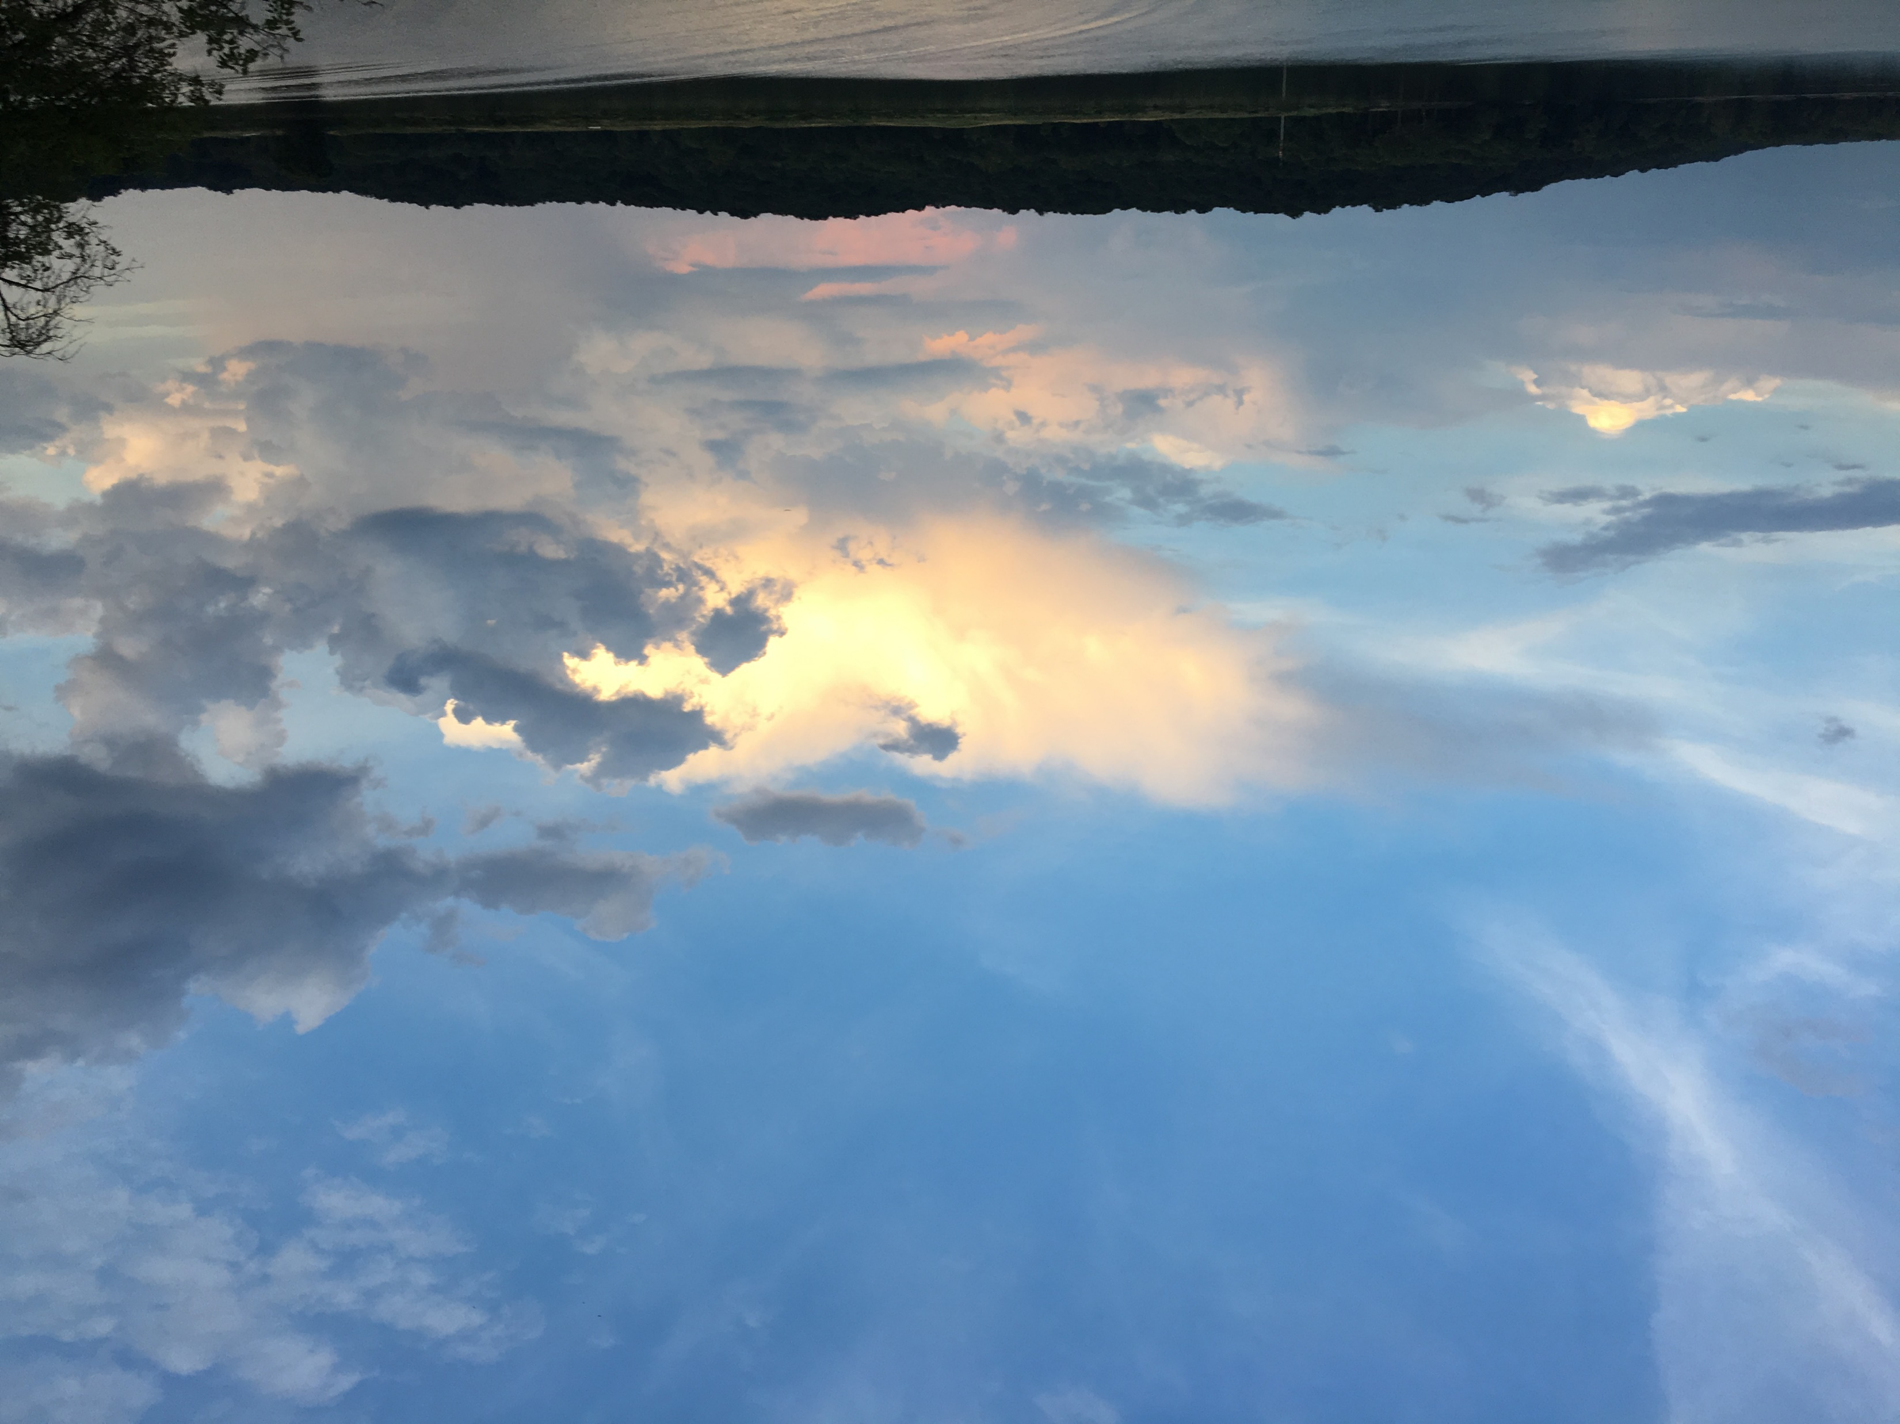
See the bright and Morning Star,
Jesus, the Light of the World.
He has risen in our hearts,
Jesus the Light of the World.
He’s the lamp that lights our way,
Jesus, the Light of the World.
Step by step and day by day
Jesus, the Light of the World!
No more darkness, no more night
Jesus, the Light of the World!
He will shine forever bright,
Jesus, the Light of the World!
Photo by James Gardner
Walk in the Light, beautiful Light;
Come where His love and His mercy are bright.
Shine all around us by day and by night,
Jesus, the Light of the World.

Slide 3
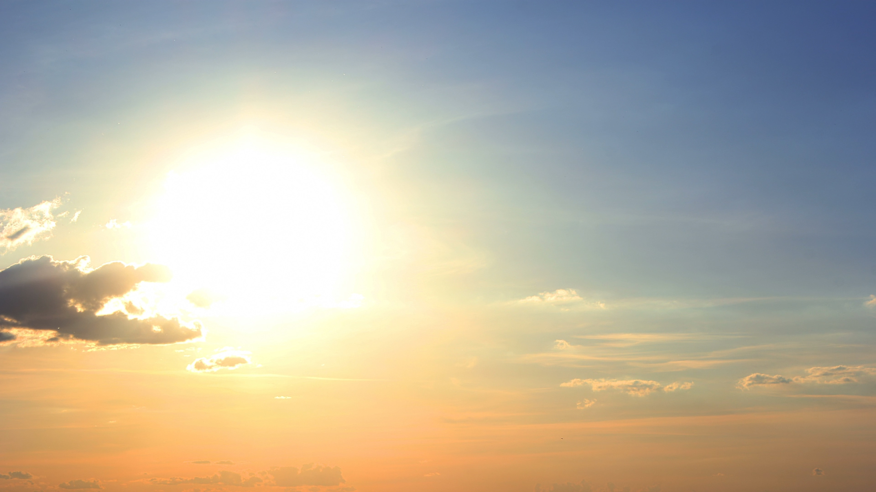
No need to fear when times of trouble come Oppression's storm beats at your door No need to fear.
No need to fear though evil seems so strong Their pride and power is not for long
No need to fear.
No need to fear the envy and the scorn Of those who boast in what they own No need to fear.
No need to fear the envy and the scorn Of those who boast in what they own No need to fear
For what remains when life's brief day is done Their glories are a setting sun But as for me, of this I'm sure God will redeem my soul from death.
And he will never fail me And in the morning I'll see his face.
And he will never fail you No one can tear you from his love And he will never forsake you And in the morning you'll see his face No need to fear--don't fear.
Be still my soul and trust in God And place your life into his hands For he will never fail you And in the morning you'll see his face No need to fear - don't fear.

