Slide 1
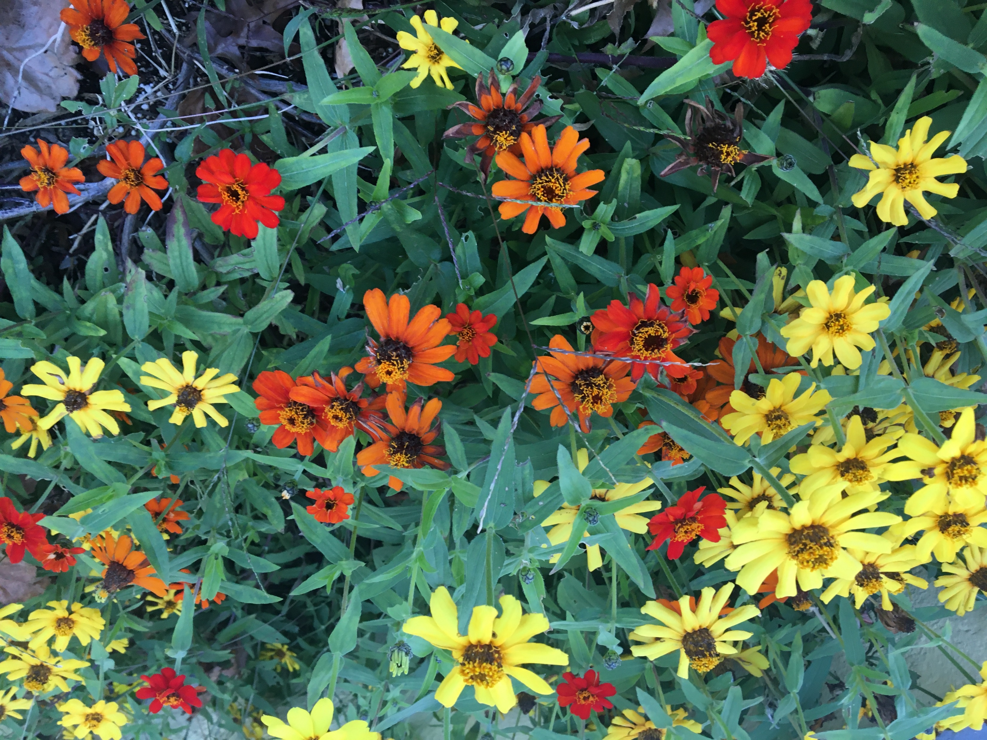
Sunday, November 29, 2020
Culmore
United Methodist Church
Word and Song
from worship service
Photo by James Gardner
Photo by James Gardner
Photo by James Gardner
Photo by James Gardner

Slide 2
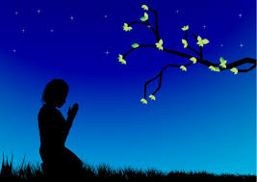
Change my heart, oh God Make it ever true. Change my heart, oh God May I be like You. You are the potter; I am the clay. Mold me and make me This is what I pray.

Slide 3
We are a wilderness wandering people on a journey of the soul.
May we find our destination in our longing to be whole.
Our Holy God is calling to us, with Jesus by our side.
May compassion be our compass; may the Spirit be our guide.
May we cherish all our children, let us heal our family’s pain.
Help us cure our city’s madness, let love and justice reign.
Reconciled with one another in prayer and praise and song,
We’re the body of Christ together and we know that we belong.

